Slide 1

Can Disney Movie Contents Compete with Netflix?
A comparative study

Slide 2
Contents
Background
Research Question
Comparison of the contents
Disney’s Growth strategy based on it’s competitive edge
Further discussions

Slide 3
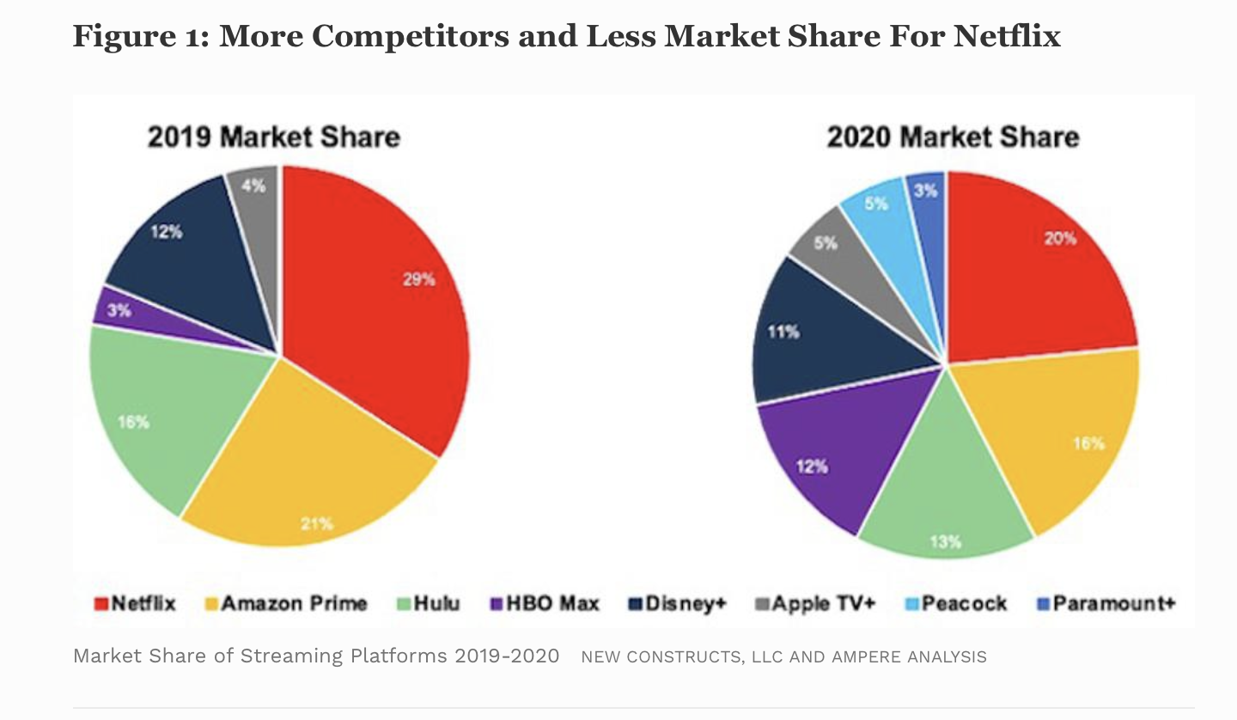
Background
Disney entered the streaming market in October 2019.
With a vast number of original productions, how does Disney Plus’ content compare with NetFlix?
Picture comes from Forbes.com, May 10, 2021,09: Netflix: a Meme – Stock Original by David Trainer of Great Spectation Groups
Notes:
-There are very few shared titles between the two networks:
101 Dalmatians
Cars 3
Little Einsteins
Finding Dory
Frozen

Slide 4
Research Question
How do the movies in Disney plus network perform in terms of ratings as compared with Netflix’ movies of the same genres?
How should Disney Plus form its strategy going forward to maintain it’s competitiveness.

Slide 5
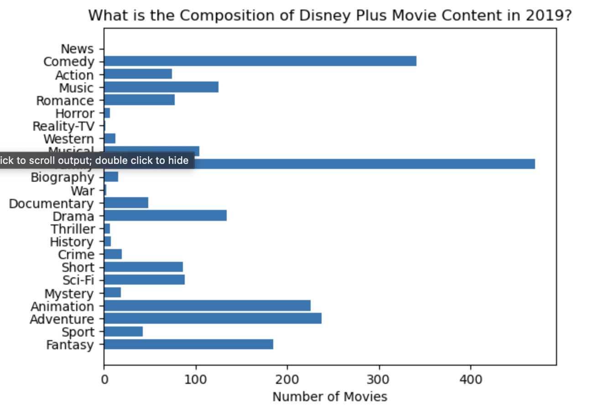
Contents of Disney Plus

Slide 6
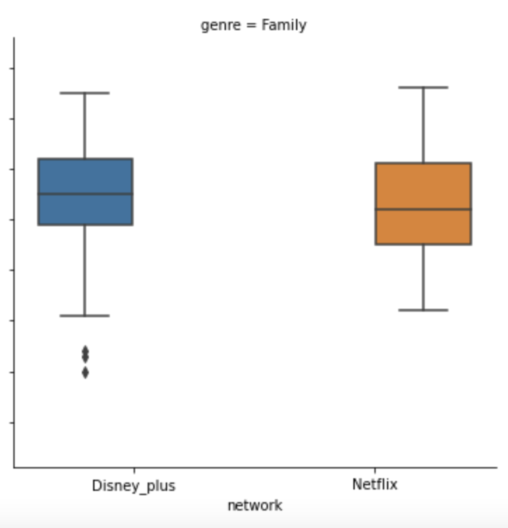
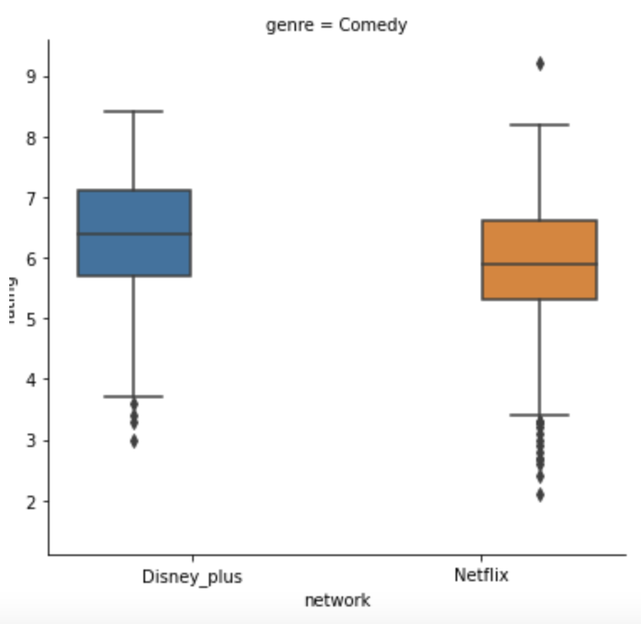
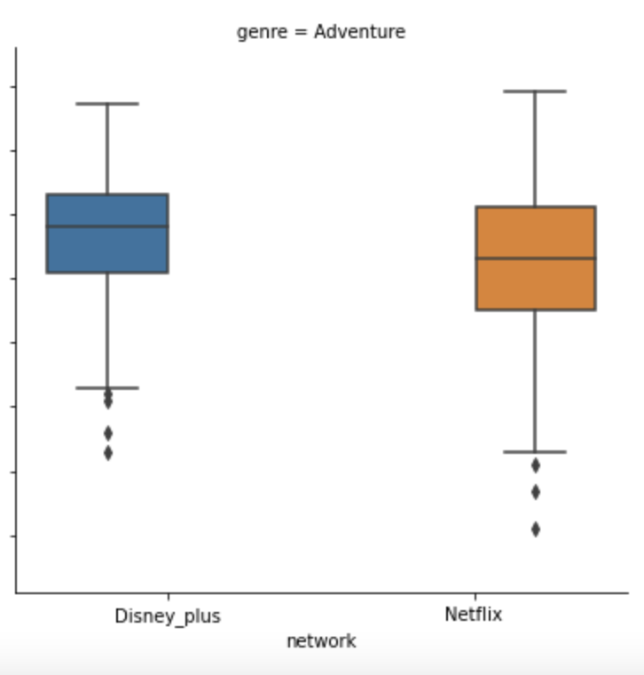
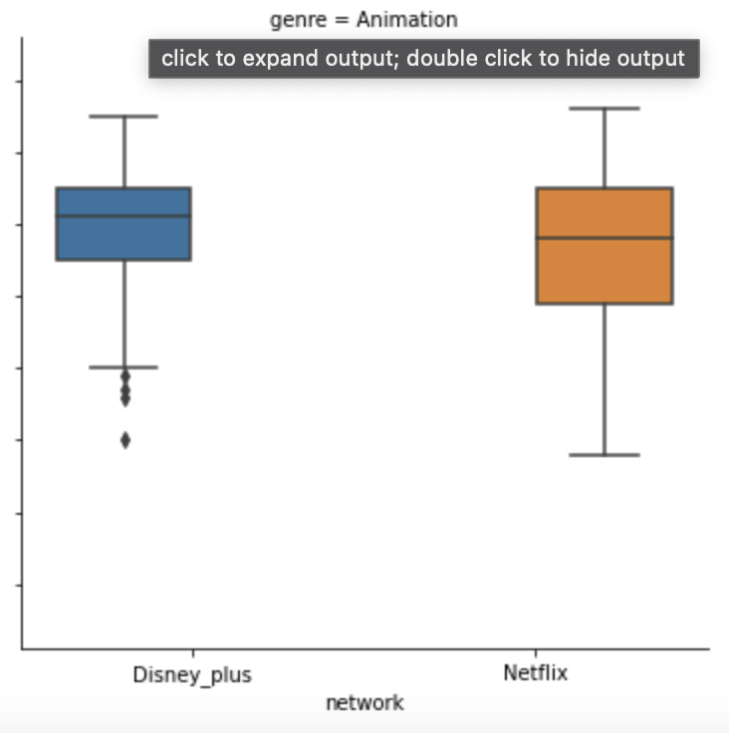
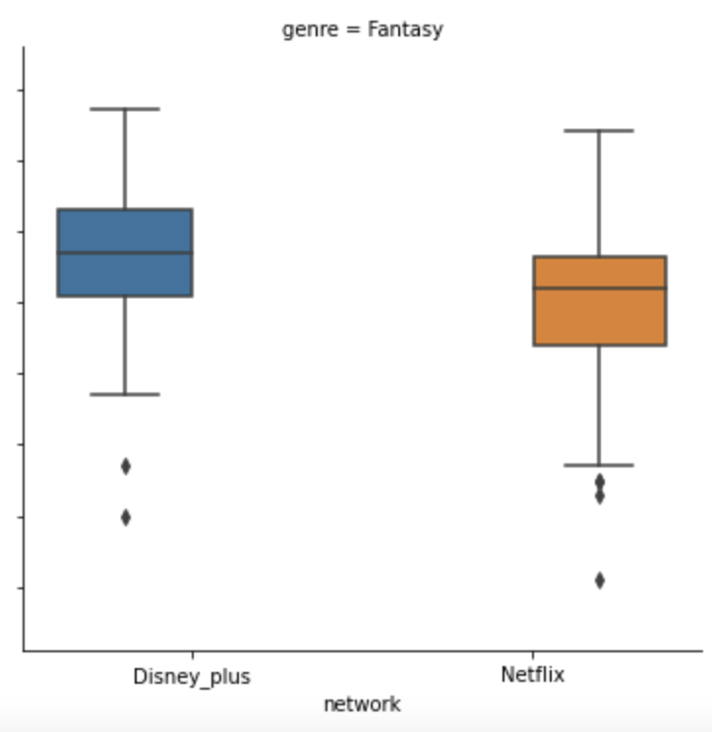
Ratings of the top 5 produced genres on Disney Plus, compared with Netflix: Families, Comedies, Adventures, Animations and Fantasies

Slide 7
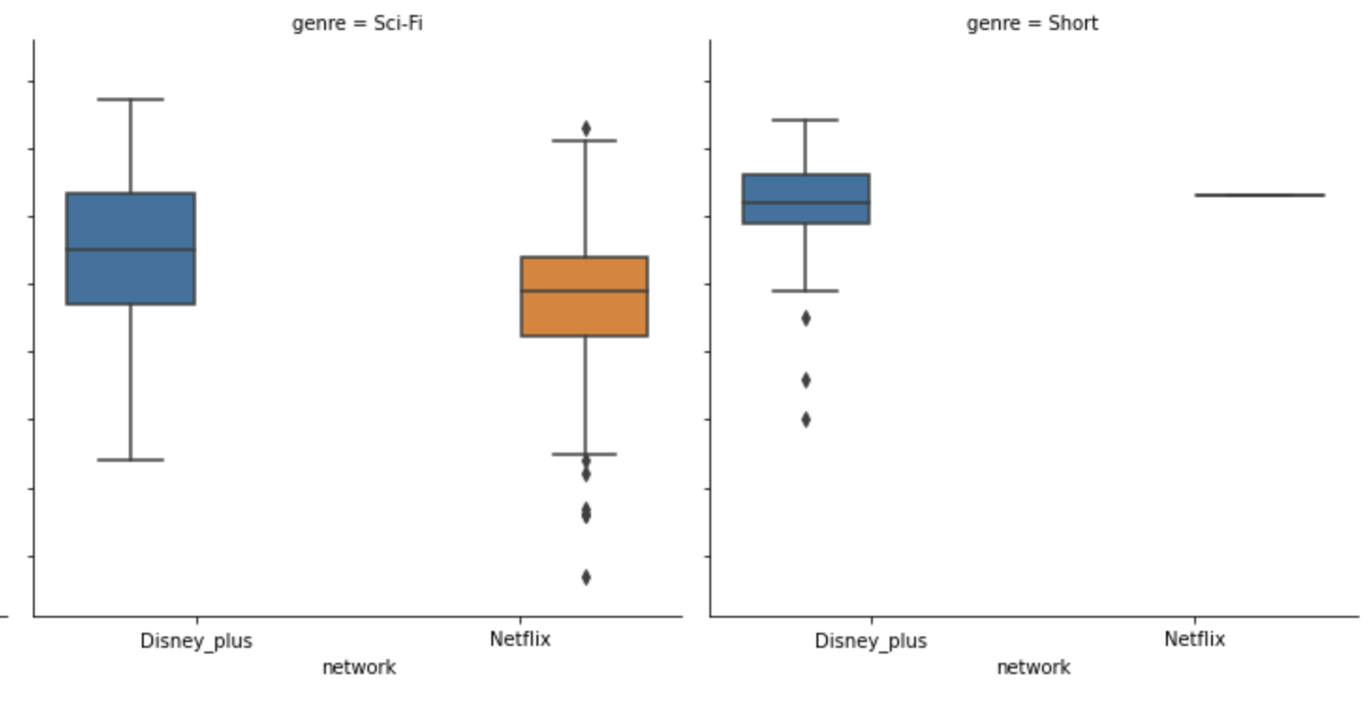
Additionally… Disney movies performance in these two categories are also worth noticing. .

Slide 8
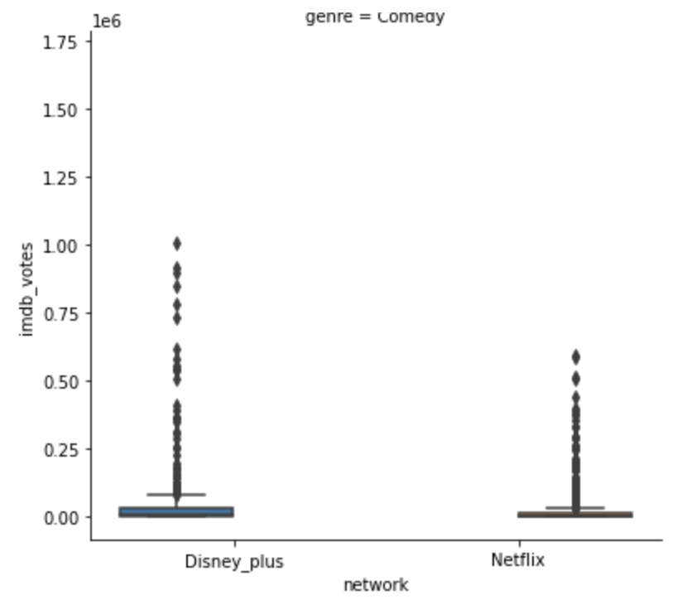
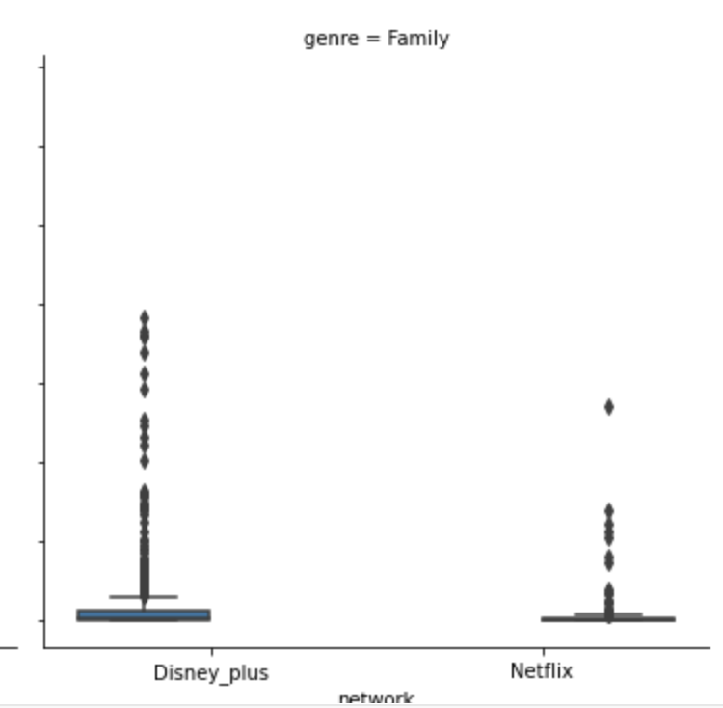
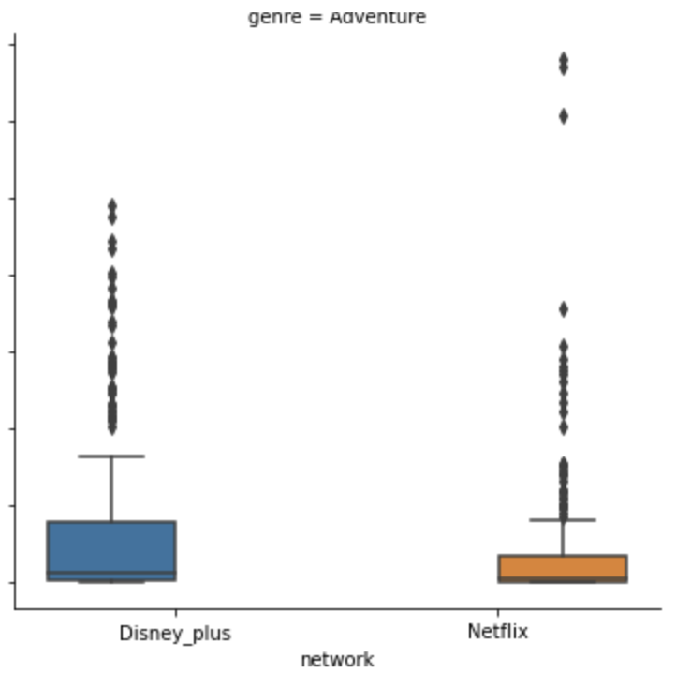
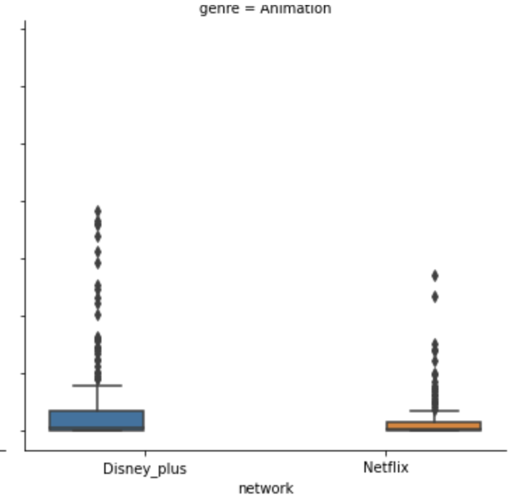
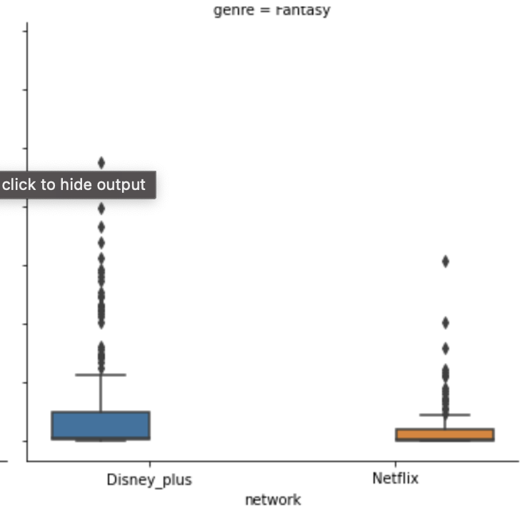
What about the influence of the network?

Slide 9
So what is Disney Plus’ strategy going forward to sustain its market share in the streaming business?
Disney Plus’ top producing genres also has grown in number, while maintaining higher IMDB ratings than Netflix.

Slide 10
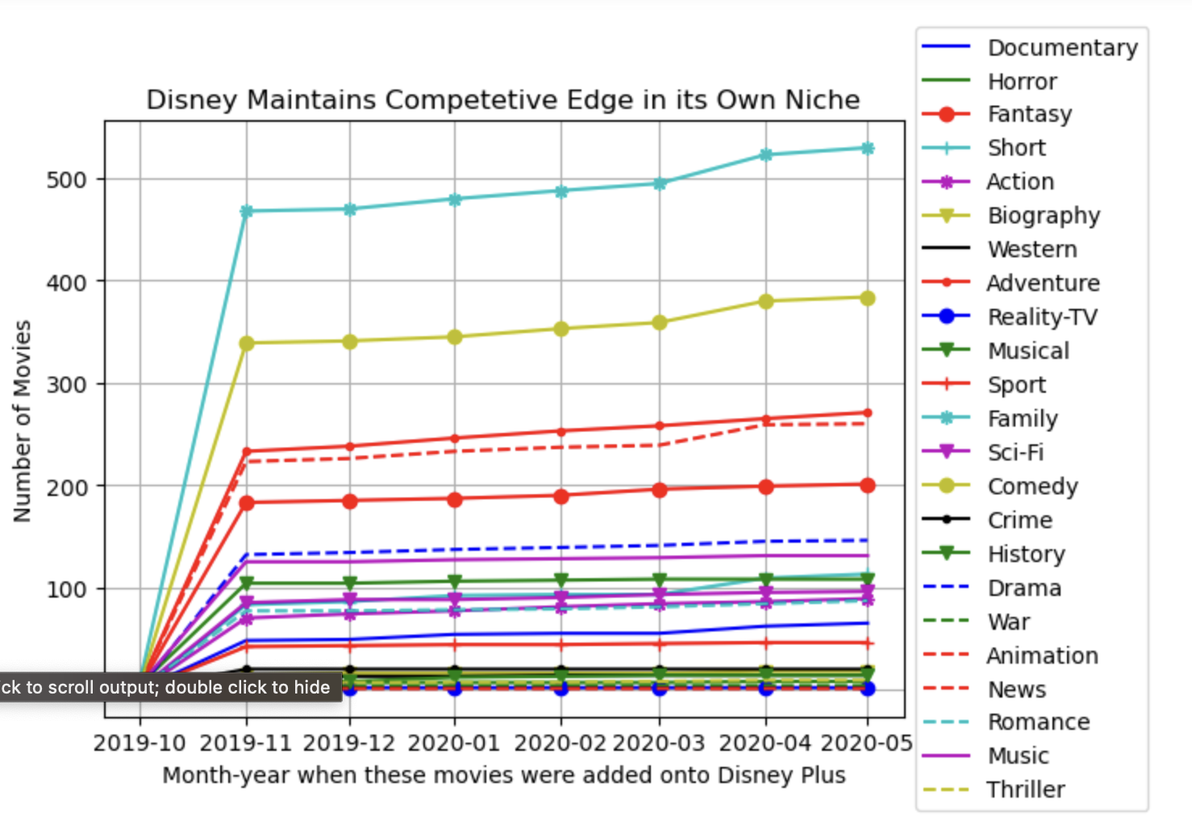

Slide 11
Grow Internationally
Network | is international? | rating
Disney _plus | Non-US | 6.37
Disney _plus | US | 6.55
Netflix | Non-US | 6.11
Netflix | US | 6.12
Network | is international? | number of movies
Disney _plus | Non-US | 144
Disney _plus | US | 573
Netflix | Non-US | 1782
Netflix | US | 1274

Slide 12
Net Steps
Integrate other metrics to evaluate the health of the network:
How the the length of the movies/TV shows affect ratings
Growth of subscription numbers
length of TV runtime analysis of the two networks.
A deeper dive into subtypes of products provided:
Movies → TV movies
TV shows → mini series

Slide 13
Appendix
Kaggle Datasets:
Disney Plus Movie and TV shows by Raphael Fontes
Netflix Movie and TV shows by Snehaan Bhawal

